Slide 1



Most sophisticated sculpture
in the world
——the making of semiconductor
PRESENTER: 張語喬 OF HGSH

Slide 2

Table of Contents
WHAT IS “MOSFET”
HOW ARE SEMICONDUCTORS MADE
Introducing “MOSFET”
“PMOS” vs. “NMOS”
Getting know about the manufacturing process of semiconductors

Slide 3

MOSFET
Metal-Oxide-Semiconductor Field-Effect Transistor
  Commonly used in both analogue electronics and digital electronics
GATE
Metal
Oxide
SOURCE
SINK
  The metal in “MOS” is usually replace by Poly-Silicon nowadays
Semiconductor
The type of MOS depends on the elements doped in “source” and “sink”
  doping with P-type elements
  doping with N-type elements
03
PMOS
NMOS

Slide 4

PMOS
vs.
NMOS
Apply Voltage
Apply Voltage
GATE
GATE
SOURCE
SINK
SOURCE
SINK
Current
  Contains an extra Electron
  Missing one Electron
create “Electron hole”
04

Slide 5

Oxidation
Metallization
Manufacturing
Process
Photolithography
Etching
OF SEMICONDUCTORS
Adding “Gate”
Ion Implantation
Pad&Protective layer
05

Slide 6
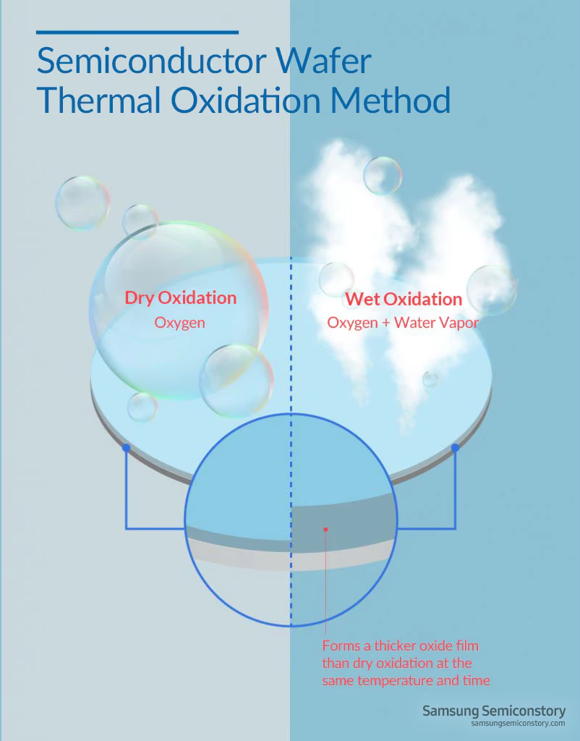
Oxidation
Thermal Oxidation Method
  Using heat to create an layer of “Silicon dioxide” on the top of the wafer
  Silicon dioxide layer and protect and insulate the wafer’s surface
  The thickness of oxidation layer is determined by the duration of heating
  Normally, the temperature of the heating is between 900-1000℃
Image source: Samsung
06

Slide 7


Metallization
  Requires materials that are:
    having low resistance
    well adhered with the insulating layer
    won’t penetrate the insulting layer
  Using heat to grow an conductive layer on the top of Silicon dioxode
  Common materials:
    Aluminum/Aluminum Alloy
    Copper
GATE
Metal
Oxide
SOURCE
SINK
Semiconductor
07

Slide 8


Photolithography
This process is aimed to create an protective layer on the designated area of the wafer’s surface
Photoresist is made with light-sensitive materials, and it’s design to change it chemical properties after being exposed to light.
METAL
SILICON DIOXIDE
SILICON
You can create the pattern you want by controlling which part shall be exposed to light with “photomask”
1.Paint the wafer’s surface with “photoresist”
08

Slide 9
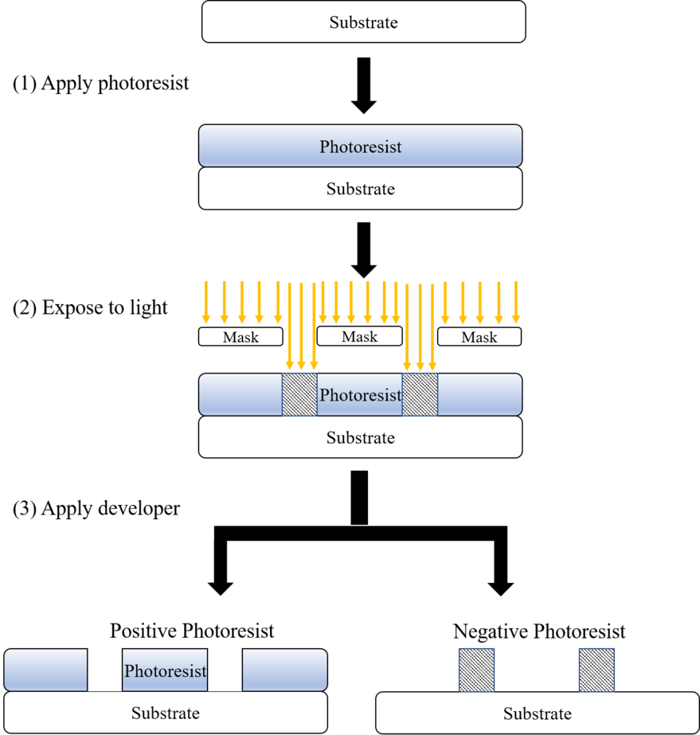
Two types of photoresist
Positive
vs.
Negative
Pattern:
Same as the photomask
Pattern:
In contrast with the photomask
09
Image source:
Wikipedia

Slide 10
Photolithography
This process is aimed to create an protective layer on the designated area of the wafer’s surface
METAL
METAL
METAL
SILICON DIOXIDE
SILICON DIOXIDE
SILICON DIOXIDE
SILICON
SILICON
SILICON
1.Paint the wafer’s surface with “photoresist”
2.Put on the “Photomask” and then irradiate the wafer
3.Using chemicals to corrode the photoresist that’s not attached to the wafer
10

Slide 11

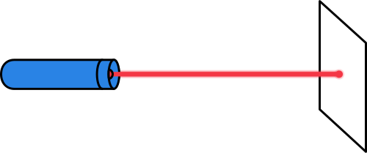

Etching
Carving trenches on the surface that aren’t shielded by the photoresist layer
METAL
METAL
SILICON DIOXIDE
Remove the hard shell of photoresist
SILICON DIOXIDE
SILICON
SILICON
  Dry etching
  Wet etching
using “plasma”
using “liquid chemical”
11

Slide 12
Adding “Gate”
Putting on poly-silicon, metal, and dioxide layer as needed
METAL
METAL
Keeping the central part as “gate”, removing other areas through photolithographing and etching
SILICON DIOXIDE
SILICON DIOXIDE
SILICON
SILICON
12

Slide 13
Ion Implantation
(Doping)
METAL
  Doping N-type or P-type elements(dopants) into semiconductors via “ion implantation” technique
SILICON
Ion implantation is a low-temperature process, in which ions of one element are accelerated into a solid target
13

Slide 14
Adding Pad&Protective Layer
Dioxide layer
Adding another dioxide layer for protection propercess
GATE
SEMICONDICTOR
SOURCE
SINK
Carving out small holes(pad), then implant metal to complete the circuit.
SEMICONDICTOR
It involves both “photolithography” and “etching” techniques to carve the pad
13

Slide 15
Q&A
15

Slide 16

How to tell if an MOS is
PMOS or NMOS?
Q&A
16

Slide 17
How to tell if an MOS is
PMOS or NMOS?
Q&A
A:It depends on the dopants used in “Source” and “Sink”
16

Slide 18

How many steps in the making process that don’t involve “photolithography” and “etching”?
Q&A
17

Slide 19
How many steps in the making process that don’t involve “photolithography” and “etching”?
Q&A
A: Two(Oxidation&Metallization)
17

Slide 20
Thanks for
Watching

